Slide 1

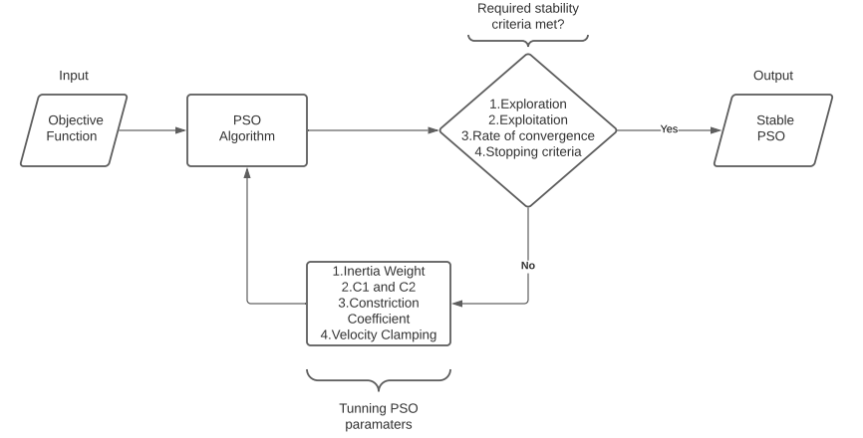
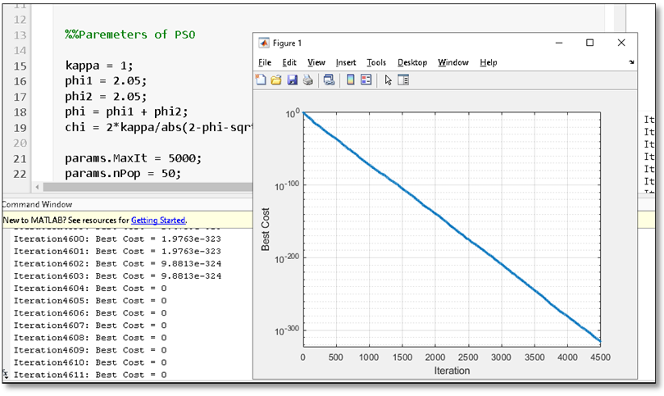
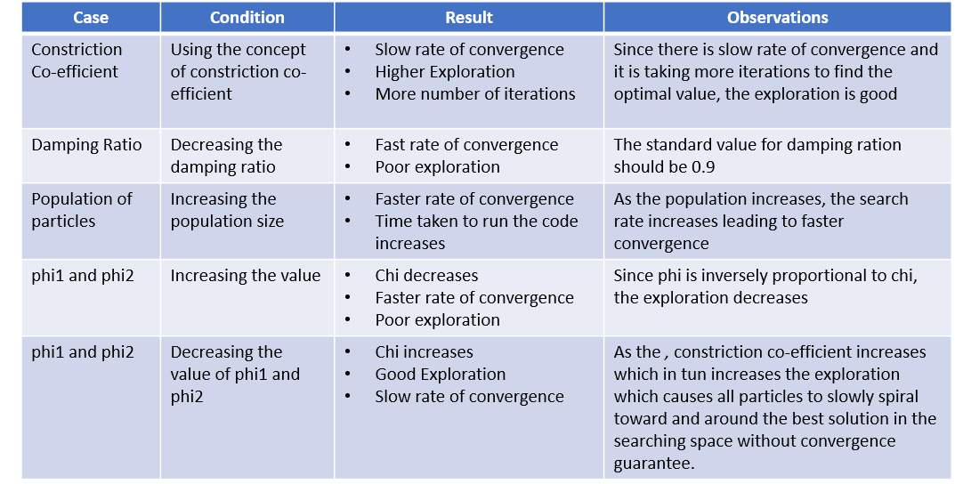
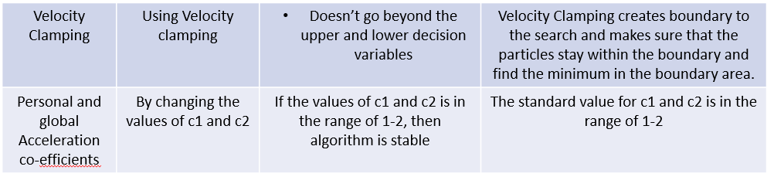
Stability Analysis of Particle Swarm Optimisation
Ifra, Ravi Kumar Radder, Spoorti Angadi, Suraj Baddi
Guide: Prof. Rohit Kalyani
School of Electronics and Communication
Problem statement
Methodology
Results
To develop stability criteria and hence evaluate the rate of convergence of particle swarm optimization.
Objectives
Numerical optimization Technique
Particle Swarm Optimization
Stability Analysis of Linear and Non-Linear systems
Propose a new methodology to determine stability of Optimization Technique
Evaluate Stability and Rate of Convergence of PSO
The input might be any objective function that has to be optimised.
The Particle Swarm Algorithm is used to optimise the objective function.
When we receive an output from PSO, we examine it for stability using three or four stability criteria, which include exploration, exploitation, rate of convergence, and stopping criteria.
We consider the algorithm to be stable if all of the stability conditions have been satisfied.
Otherwise, we tune the parameters of PSO using concepts such as constriction co-efficient, velocity clamping, inertia weight, and acceleration co-efficients.
Contributions
Because the Particle Swarm algorithm is used to find the optimal value, it can be applied in a various fields.
It can be used in any closed loop controller to minimize the errors.
In lateral and longitudinal closed loop controller to tune the parameters of that particular controller
Literature survey
Optimization
Mathematical framework for stability and convergence
Parameter tuning
Role of benchmarking
Performance measure for fair comparison
Large scale scalability
If else ladder
For loop is used to repeat a snippet of code for a certain number of times until the condition becomes false.
Functions to avoid rewriting of same logic/code again and again in the program
Conclusions
The parameters of Particle Swarm Optimization were tuned to maintain stability criteria like Exploration, Exploitation, and Convergence Rate.

